Slide 1
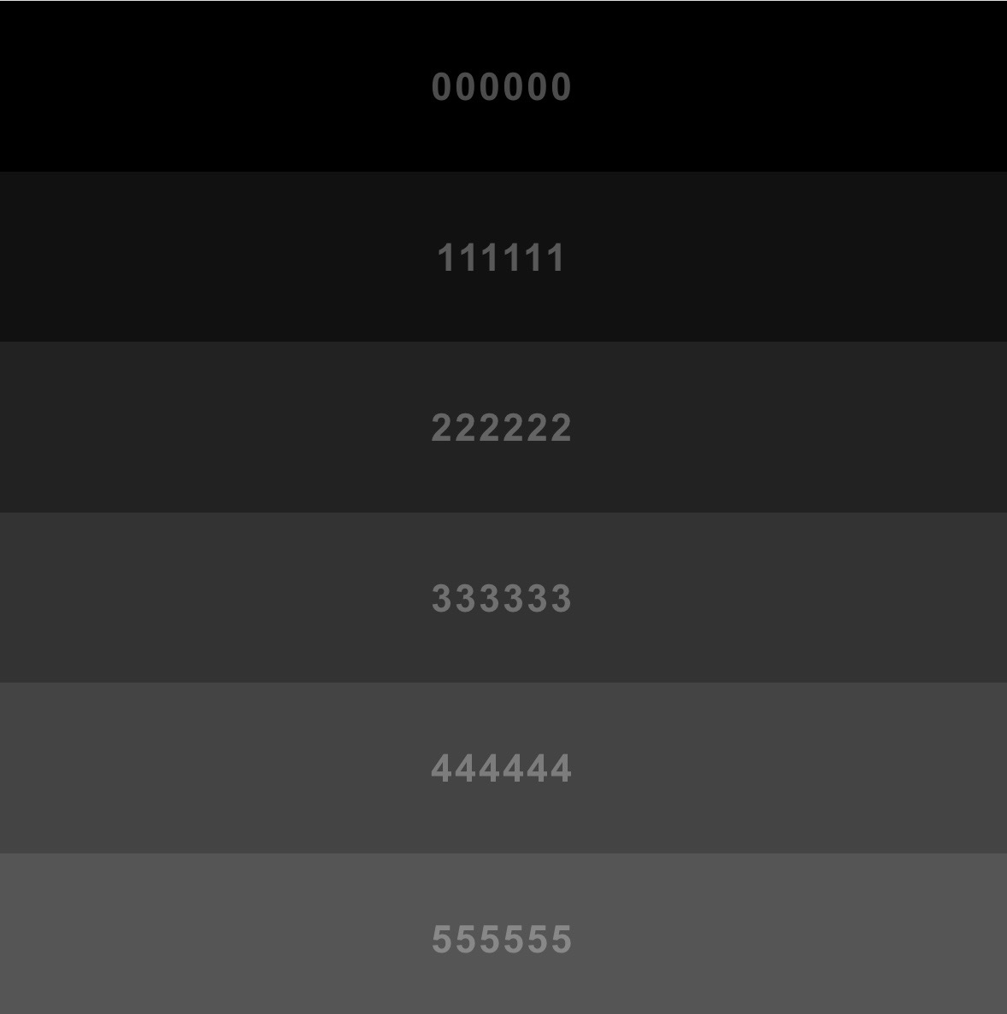

MTG HUMPRHEYS TABLETOP
BATTLE & BREW
Sample color
For take out cups
SYRUPS
SINK
BLENDER
Extra espresso (later)
OVEN
Top table color (chesnut brown)
Entrance
Ice machine(near under sink)
530x650 x 860
(WxDxH mm)
Coffee back bar drawers (grayish black)
BACK BAR SIZE
L3.2mD0.65mxH0.90m
WALK WAY 1.0M
2 Door fridge under counter
160x 700 x 850
(WxDxH cm)
Cups T/out
Top table color (chesnut brown)
ESPRESSO MACHINE
680x 512 x 420
(WxDxH mm)
POS/
ORDER HERE
PICK UP HERE
GRINDER
300x210x560 (WxDxH)mm
pastry display
10.5 x 11.5 x 11
(WxDxH mm)
Hot water
249x300x555
(WxDxH)mm
Coffee front bar table (grayish black)
MAIN BAR COUNTER SIZE
L4.0mxD0.75mxH0.90m

